Slide 1
Group Project 447
Wordle Coach
Team Odin

Slide 2
Wordle History
Wordle was created by Josh Wardle and his partner Palak Shah. Wordle initially started around 2013 when he was learning app development.
Originally, the word list was up to 13,000 words He went back to it during the pandemic after dropping the idea and crunched the list to about 2,000 words (2,309 words to be exact). It was released in October 2021 when it was just for him, his partner, and his friends.
He made sure that you can only play once a day and that it will be on a website and not an app because he was good at web development not app development.
It was on a public website for 6 months (only for him and Palak) and then once Wardle shared it to his family members, it spread like wildfire. It got so popular that he couldn’t keep up it regulating it so he sold it to New York Times in January 31, 2022 for 7 figures.
Notes:
Parth
https://www.protocol.com/bulletins/josh-wardle-wordle-gdc-2022
https://www.upworthy.com/wordle-the-wholesomely-simple-word-game?rebelltitem=2#rebelltitem2
https://theygotacquired.com/gaming/wordle-acquired-by-the-new-york-times/

Slide 3
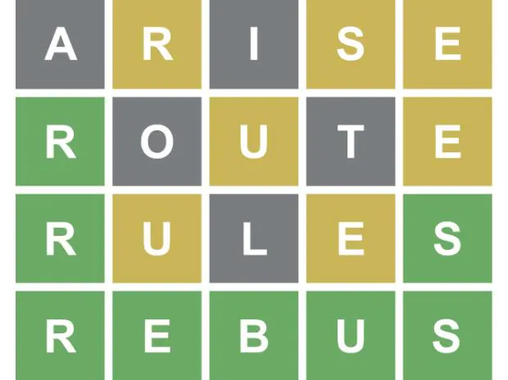
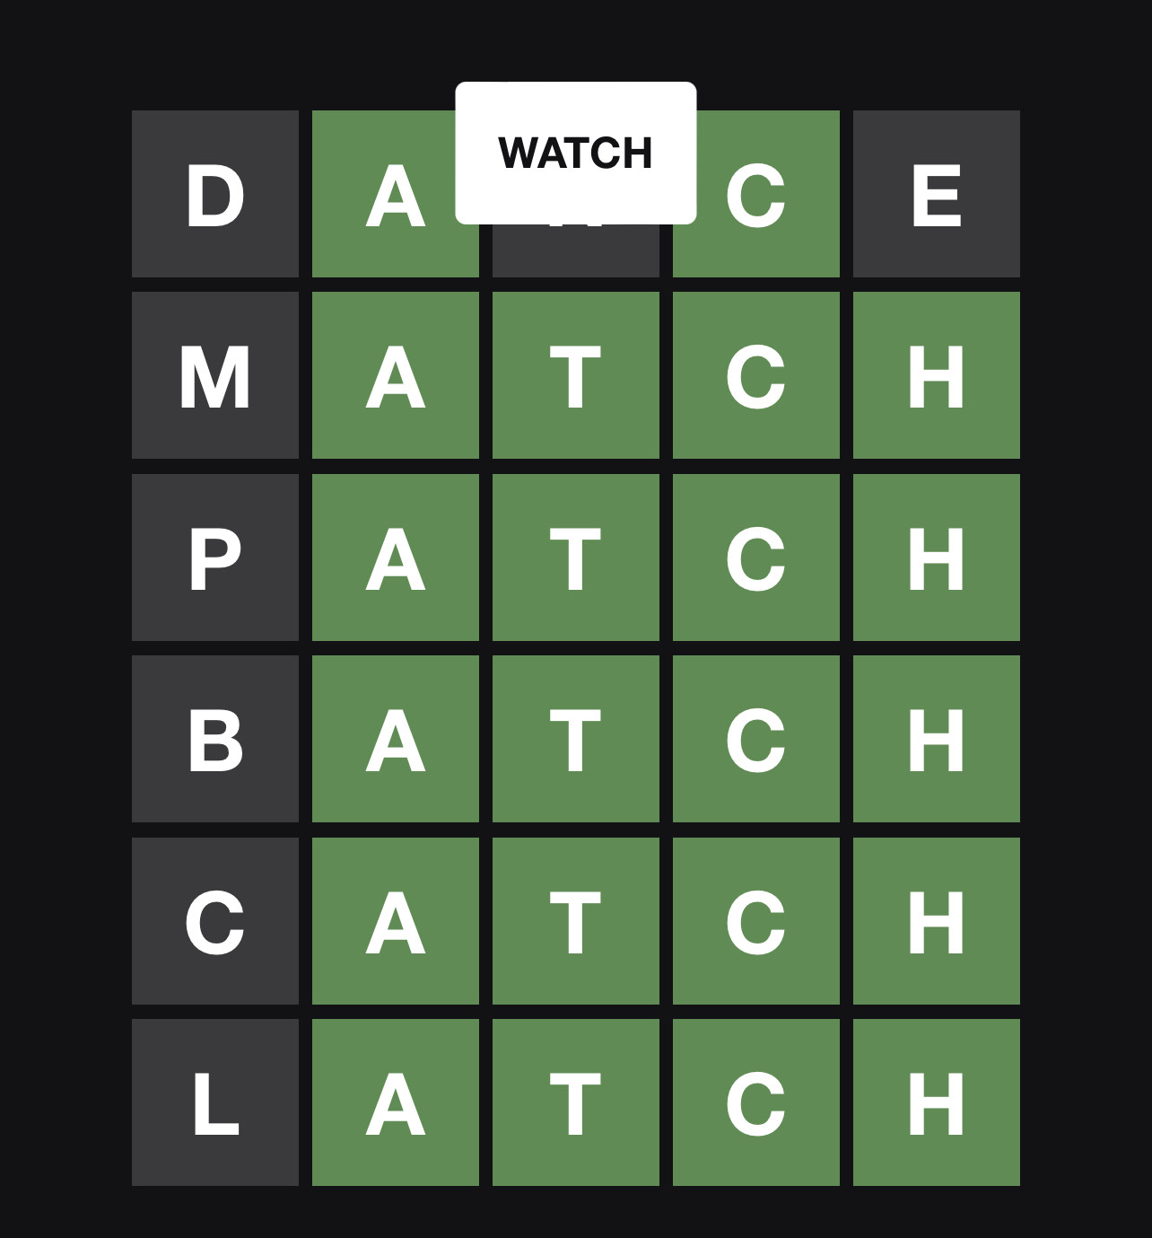
How Wordle Works
1
2
3
4
Users have six chances to guess a predetermined 5-letter word
Each guess must be a word, each letter will turn a certain color
Green: the letter is in the word, and is in the correct spot
Yellow: the letter is in the word, and is not in the correct spot
Gray: the letter is not in the word
Sometimes, a letter might be used more than once in the word
There are strategies that help to guess the word more quickly
Letter use frequencies
Letter positions in the word
Notes:
Nathan

Slide 4
The Wordle Coach
A tool to use while playing wordle on a separate device.
Presents the user with a list of statistically strategic suggestion words to start
Will analyze the output after each guess and suggest the statistically best options to narrow down the answer
User has the option to use the generated guesses or their own
Does not answer the puzzle for the user, It only helps them make good guesses
A simple and easy to use UI with a familiar style to Wordle.
Runs on portable Android devices
Notes:
Jamie

Slide 5
Why This Product?
Wordle is one of the most popular games in the world targeting all ages
According to The Conversion Wordle has nearly 3 million current players akin to other popular games like Fortnite with 2-4 million current players
Every daily Wordle has one answer for all players
Players share each other's scores making it competitive
Wordle Coach gives players a hint without revealing the answer
Wordle Coach helps players improve their guesses
Notes:
Jamie
Sources:
https://theconversation.com/codecracking-community-and-competition-why-the-word-puzzle-wordle-has-become-a-new-online-obsession-174878
Sources:
https://www.dexerto.com/fortnite/how-many-people-play-fortnite-player-count-1666278/

Slide 6
Required Roles
Facilitator(Zan Wills): Handles communication between the professor/TA and the team
Customer(Jamie Kirk): Will be giving the requirements and have final decision in design specifications
Notes:
Dennis

Slide 7
Roles Continued
Developers(Everyone):
Zan Wills: Create and manage solver algorithm library, UI development support
Jamie Kirk: Focus on implementing the solving algorithm
Nathan Hoernlein: Creating UI and help implement solving algorithm
Parth Patel: Creating UI and help implement solving algorithm
Dennis Mayher: Creating UI and help implement solving algorithm
Notes:
Dennis

Slide 8
Implementation Description
Android App written in Kotlin
App instance local to the device
Main components:
UI
Algorithm to filter and select words
Algorithm Design Prototype
Master list of 5 letter words
Each “play” create new list containing only the words which match the user entered criteria
Sort list by most common
UI
Empty word board
User enters word then selects “status” of each letter
Notes:
Zan

Slide 9
Questions

